Slide 1
LTO performance - Make Tape Reading Great Again -
HEPiX Fall 2018, Barcelona
Germán Cancio Meliá – CERN IT/ST german.cancio@cern.ch
LTO performance – HEPiX Fall 2018 – German.Cancio@cern.ch

Slide 2
Agenda
Status of LTO at CERN
(Read) Performance characteristics
Investigations, results and improvements
LTO performance – HEPiX Fall 2018 – German.Cancio@cern.ch

Slide 3
LTO: status at CERN
CERN continues multi-vendor, multi-platform strategy for tape
Keep flexibility in technology, avoid commercial lock-ins
Shift from {IBM enterprise, Oracle} to {IBM enterprise, LTO} initiated
New LTO library purchased: IBM TS4500, 10K slots base, 20 LTO-8 drives, 6PB media (7M and 8)
Successfully validated and put in production (July 2018)
Open tendering of additional media with interesting price/TB
Another LTO library to be procured during LS2 (open tender)
Oracle enterprise progressively being decommissioned + media repacked by end LS2
LTO performance – HEPiX Fall 2018 – German.Cancio@cern.ch

Slide 4
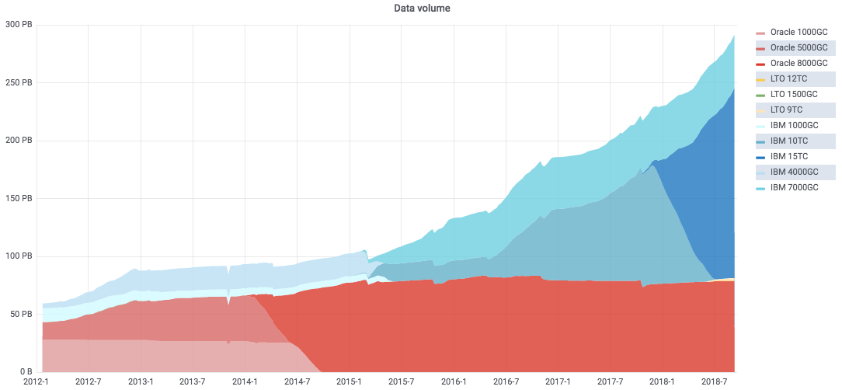
LTO usage at CERN
LTO (2.8PB)
(<1% of total)
LTO performance – HEPiX Fall 2018 – German.Cancio@cern.ch
4

Slide 5
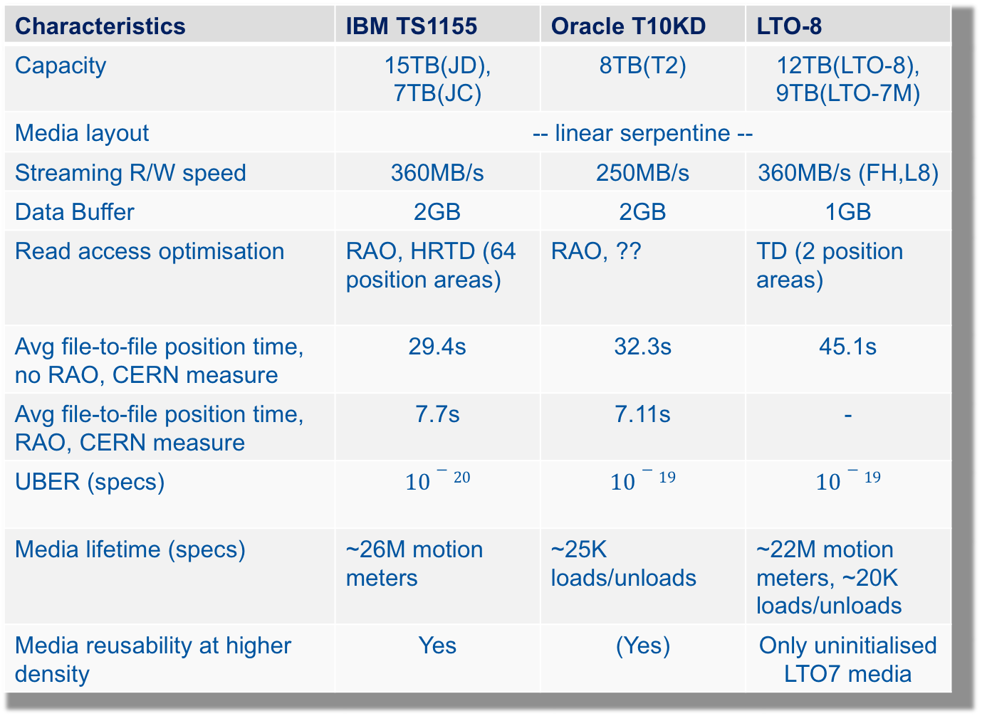
LTO vs Enterprise: key points
Characteristics | IBM TS1155 | Oracle T10KD | LTO-8
Capacity | 15TB(JD), 7TB(JC) | 8TB(T2) | 12TB(LTO-8), 9TB(LTO-7M)
Media layout | -- linear serpentine --
Streaming R/W speed | 360MB/s | 250MB/s | 360MB/s (FH,L8)
Data Buffer | 2GB | 2GB | 1GB
Read access optimisation | RAO, HRTD (64 position areas) | RAO, ?? | TD (2 position areas)
Avg file-to-file position time, no RAO, CERN measure | 29.4s | 32.3s | 45.1s
Avg file-to-file position time, RAO, CERN measure | 7.7s | 7.11s | -
UBER (specs) | $$10−20$$ | $$10−19$$ | $$10−19$$
Media lifetime (specs) | ~26M motion meters | ~25K loads/unloads | ~22M motion meters, ~20K loads/unloads
Media reusability at higher density | Yes | (Yes) | Only uninitialised LTO7 media

Slide 6
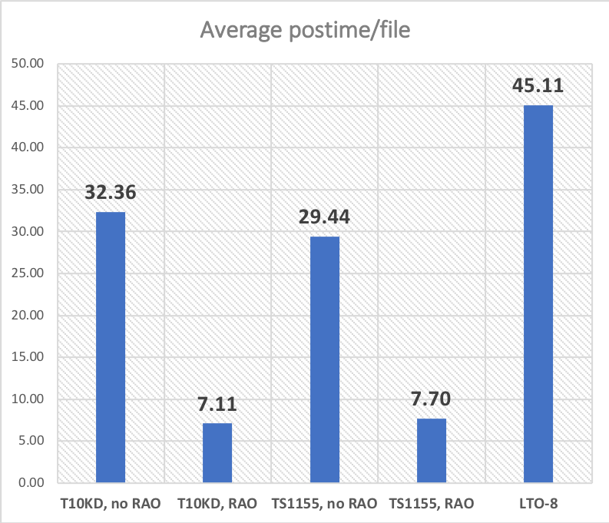
LTO reading efficiency
LTO-8 R/W streaming performance == IBM enterprise
However, positioning times are significantly worse -> much slower effective speed
Reasons:
Slower seek speeds (~25%)
Lack of high-resolution tape directory -> hi-speed positioning areas
TS1155 has 64 across tape length
LTO-8 only has 2
Lack of drive-assisted request ordering (RAO) -> files are read in logical ID order, which due to serpentine tape layout is almost as bad as random ordering
5.8x slower
LTO performance – HEPiX Fall 2018 – German.Cancio@cern.ch

Slide 7
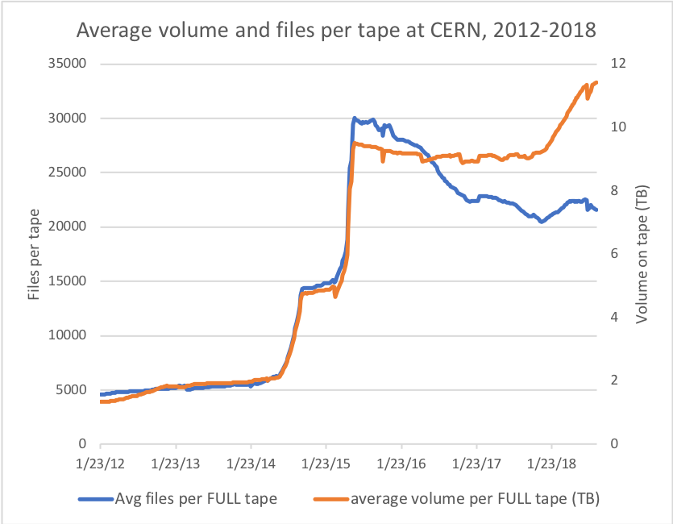
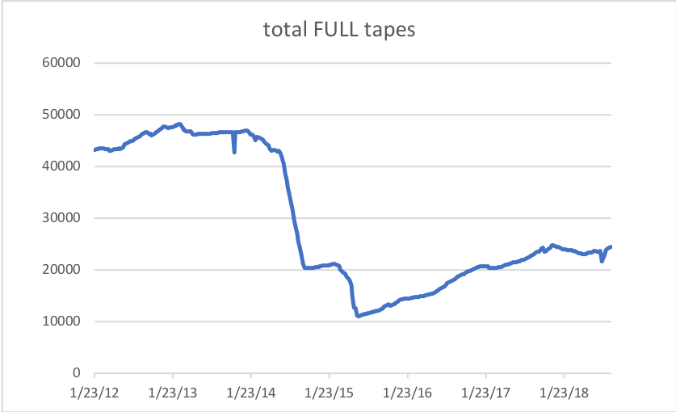
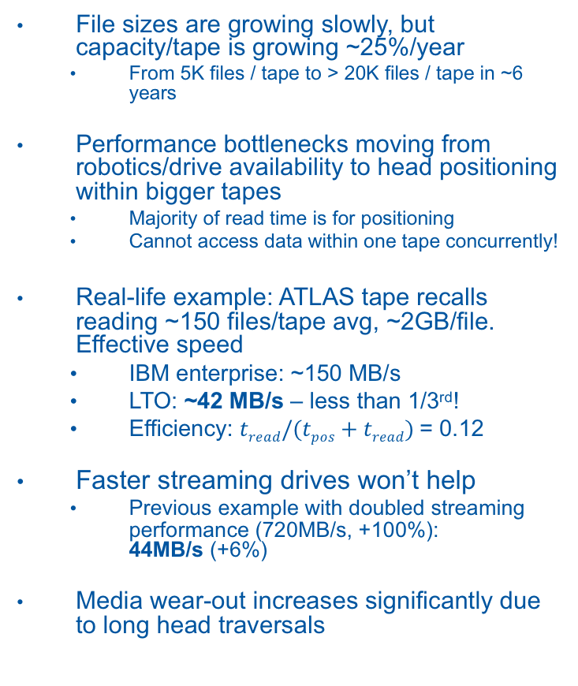
Impact
File sizes are growing slowly, but capacity/tape is growing ~25%/year
From 5K files / tape to > 20K files / tape in ~6 years
Performance bottlenecks moving from robotics/drive availability to head positioning within bigger tapes
Majority of read time is for positioning
Cannot access data within one tape concurrently!
Real-life example: ATLAS tape recalls reading ~150 files/tape avg, ~2GB/file. Effective speed
IBM enterprise: ~150 MB/s
LTO: ~42 MB/s – less than 1/3rd!
Efficiency: $tread/(tpos+tread)$= 0.12
Faster streaming drives won’t help
Previous example with doubled streaming performance (720MB/s, +100%): 44MB/s (+6%)
Media wear-out increases significantly due to long head traversals
LTO performance – HEPiX Fall 2018 – German.Cancio@cern.ch

Slide 8
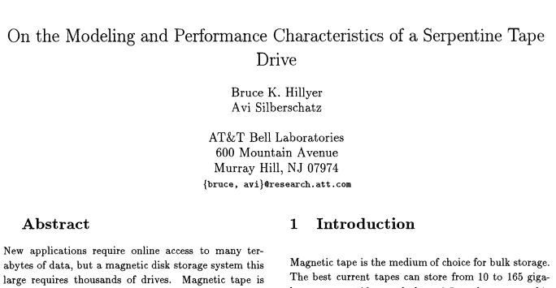
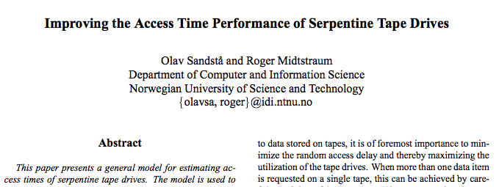
So, what to do?
One possibility is just to live with it
use LTO for “old” and/or “unused” data, such as media migrations of previous run data, or RAW data that should be recalled rarely.
Another possibility is to purchase a Spectralogic T-Finity
Their customised LTO drives offer a TAOS – Time-based Access Ordering System, using generic heuristics to emulate RAO at SCSI level
Optimising read performance of serpentine tape drives is not a new problem, there was some research done 20 years ago (long before LTO), but seemingly got forgotten… let’s pick up from there…
1996
1999
LTO performance – HEPiX Fall 2018 – German.Cancio@cern.ch

Slide 9
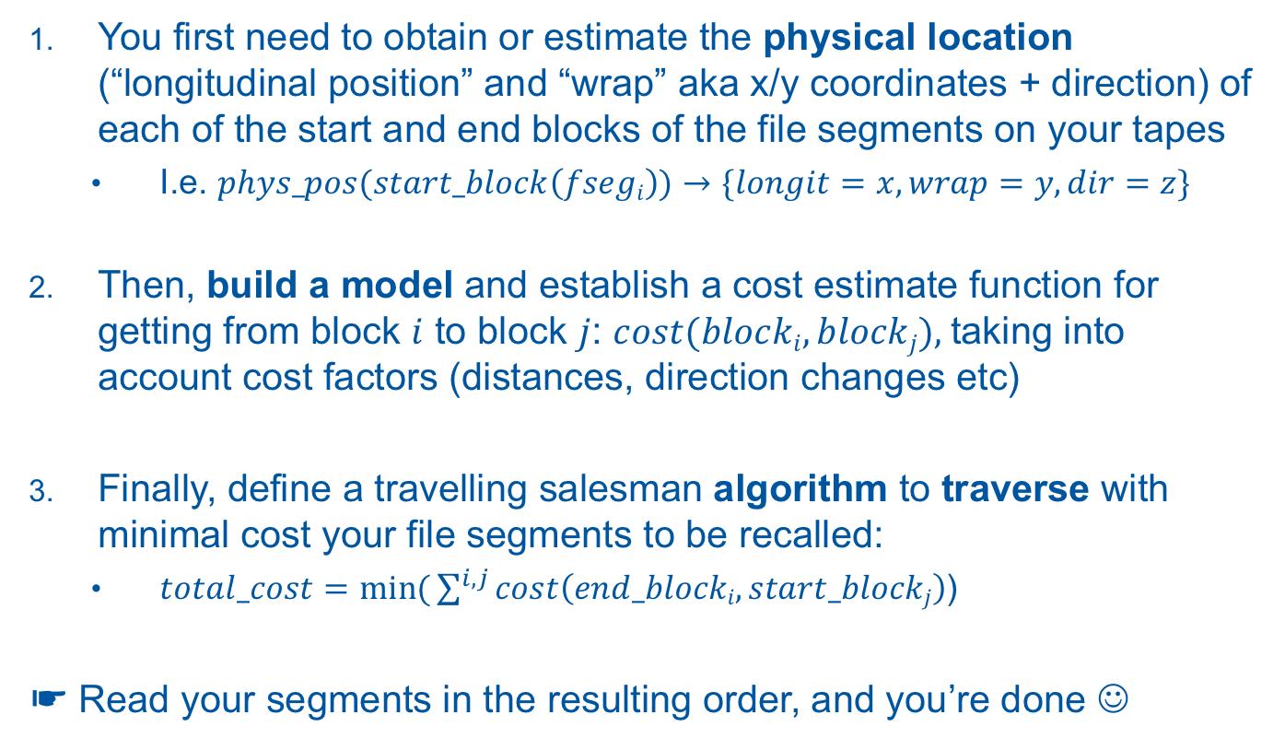
How to improve positioning times?
You first need to obtain or estimate the physical location (“longitudinal position” and “wrap” aka x/y coordinates + direction) of each of the start and end blocks of the file segments on your tapes
I.e. $phys_pos(start_block\left(fsegi\right))→\{longit=x, wrap=y, dir=z\}$
Then, build a model and establish a cost estimate function for getting from block $i$ to block $j$: $cost(blocki,blockj),$taking into account cost factors (distances, direction changes etc)
Finally, define a travelling salesman algorithm to traverse with minimal cost your file segments to be recalled:
$total_cost=\min{(}\sum^{i,j}{cost\left(end_blocki,start_blockj\right)}$)
☛ Read your segments in the resulting order, and you’re done ☺
LTO performance – HEPiX Fall 2018 – German.Cancio@cern.ch

Slide 10
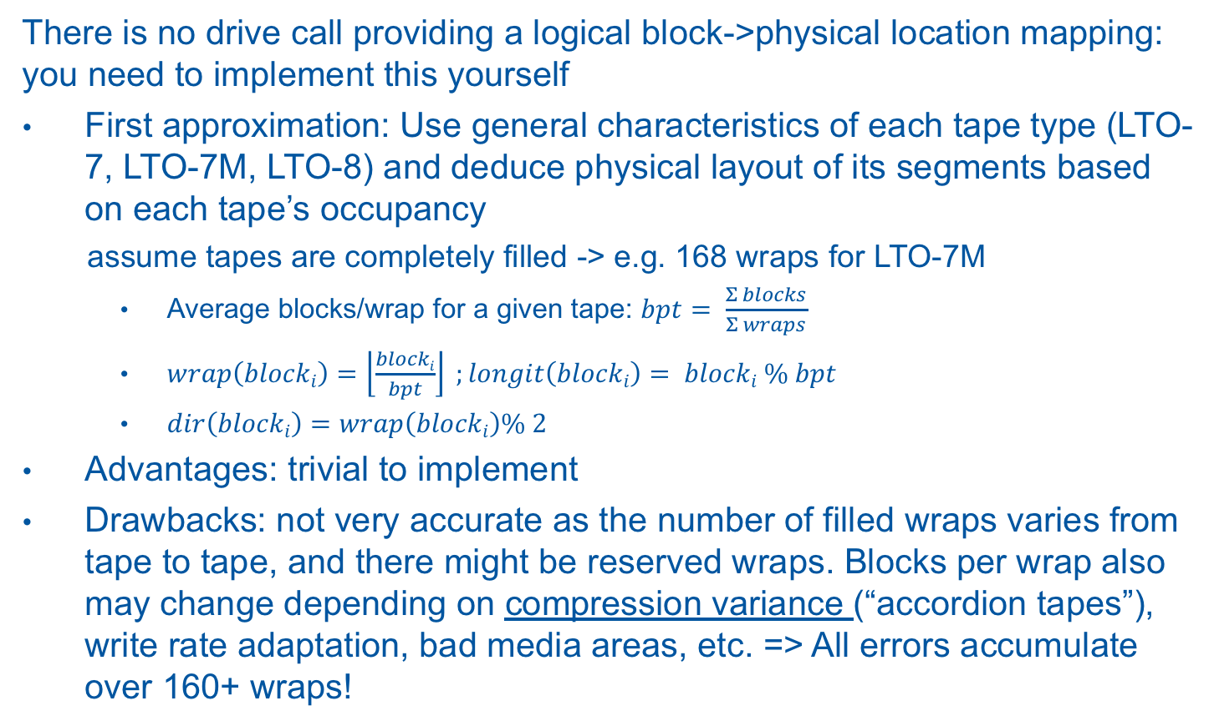
1. Physical location of segments (I)
There is no drive call providing a logical block->physical location mapping: you need to implement this yourself
First approximation: Use general characteristics of each tape type (LTO-7, LTO-7M, LTO-8) and deduce physical layout of its segments based on each tape’s occupancy
assume tapes are completely filled -> e.g. 168 wraps for LTO-7M
Average blocks/wrap for a given tape: $bpt= \frac{Σ blocks}{Σ wraps}$
$wrap\left(blocki\right)=\left\lfloor \frac{blocki}{bpt}\right\rfloor ;longit\left(blocki\right)= blocki \% bpt$
$dir\left(blocki\right)=wrap\left(blocki\right)\% 2$
Advantages: trivial to implement
Drawbacks: not very accurate as the number of filled wraps varies from tape to tape, and there might be reserved wraps. Blocks per wrap also may change depending on compression variance (“accordion tapes”), write rate adaptation, bad media areas, etc. => All errors accumulate over 160+ wraps!
LTO performance – HEPiX Fall 2018 – German.Cancio@cern.ch

Slide 11


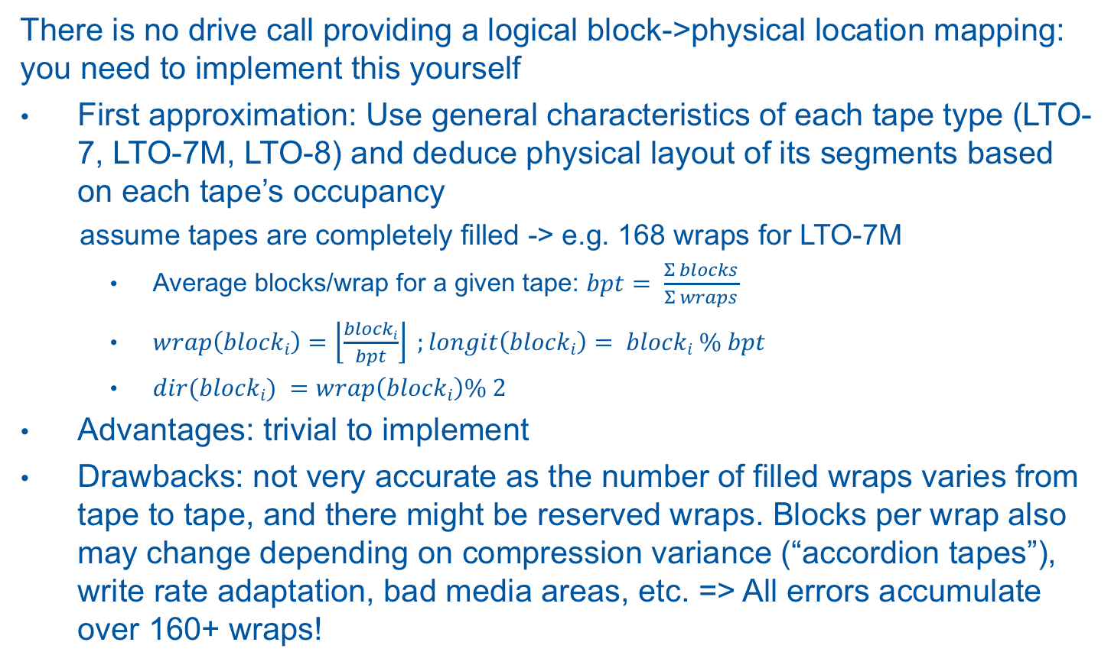
1. Physical location of segments (I)
There is no drive call providing a logical block->physical location mapping: you need to implement this yourself
First approximation: Use general characteristics of each tape type (LTO-7, LTO-7M, LTO-8) and deduce physical layout of its segments based on each tape’s occupancy
assume tapes are completely filled -> e.g. 168 wraps for LTO-7M
Average blocks/wrap for a given tape: $bpt= \frac{Σ blocks}{Σ wraps}$
$wrap\left(blocki\right)=\left\lfloor \frac{blocki}{bpt}\right\rfloor ;longit\left(blocki\right)= blocki \% bpt$
$dir(blocki) =wrap\left(blocki\right)\% 2$
Advantages: trivial to implement
Drawbacks: not very accurate as the number of filled wraps varies from tape to tape, and there might be reserved wraps. Blocks per wrap also may change depending on compression variance (“accordion tapes”), write rate adaptation, bad media areas, etc. => All errors accumulate over 160+ wraps!
LTO performance – HEPiX Fall 2018 – German.Cancio@cern.ch

Slide 12
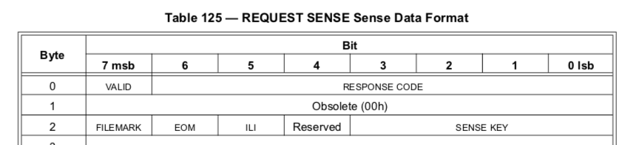
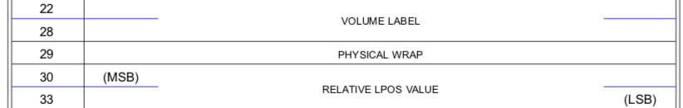
1. Physical location of segments (II)
There is no drive call providing a logical block->physical location mapping: you need to implement this yourself
Second approximation: RTFM… and use the REQUEST SENSE SCSI command to find out the current physical location of the tape head
Source: IBM Ultrium LTO Tape Drive SCSI Reference Manual
LTO performance – HEPiX Fall 2018 – German.Cancio@cern.ch

Slide 13
1. Physical location of segments (II)
There is no drive call providing a logical block->physical location mapping: you need to implement this yourself
Second approximation: RTFM… and use the REQUEST SENSE SCSI command to find out the current physical location of the tape head
physical wrap: from 0 to 167 (LTO-7M) or 203 (LTO-8)
LPOS (longitudinal position) units: from 0 to 171144, counted from BOT
This information can be obtained either during reading or writing - at no noticeable performance loss
Record wrap/LPOS of the beginning or end of each newly written segment and keep it along with fseq and blockID in your tape catalogue
Requires (of course) modifications to your MSS software!
# sg_requests -H /dev/sg1
00 70 00 00 00 00 00 00 58 00 00 00 00 00 00 30 00
10 00 00 00 00 01 01 4c 37 30 30 36 33 4d 02 00 01
20 1a 77 56 00 00 00 00 56 81 00 60 4d 38 00 07 b0
wrap: 02h
LPOS: 00011A77h
LTO performance – HEPiX Fall 2018 – German.Cancio@cern.ch

Slide 14
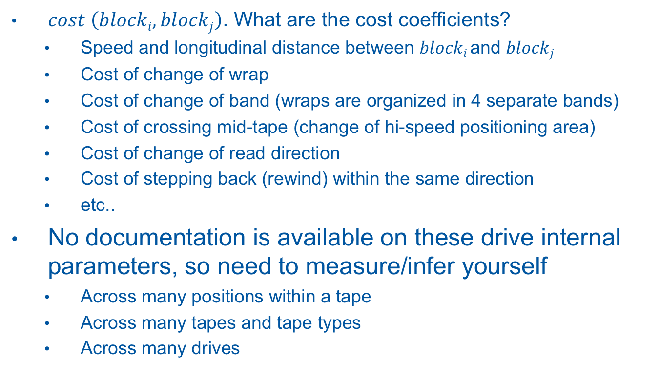
2. Modeling positioning cost (I)
$cost \left(blocki,blockj\right)$. What are the cost coefficients?
Speed and longitudinal distance between $blocki$and $blockj$
Cost of change of wrap
Cost of change of band (wraps are organized in 4 separate bands)
Cost of crossing mid-tape (change of hi-speed positioning area)
Cost of change of read direction
Cost of stepping back (rewind) within the same direction
etc..
No documentation is available on these drive internal parameters, so need to measure/infer yourself
Across many positions within a tape
Across many tapes and tape types
Across many drives
LTO performance – HEPiX Fall 2018 – German.Cancio@cern.ch

Slide 15
2. Modeling positioning cost (II)
Generate tape read workloads (on real data) and collect physical position information (from, to, time)
Using multilinear regression to obtain values for cost coefficients
Compare expectations vs measurements and repeat over several iterations
In total, analysed 800K positions across 8400 mounts, 140 LTO-7M tapes and 20 drives
LTO performance – HEPiX Fall 2018 – German.Cancio@cern.ch

Slide 16
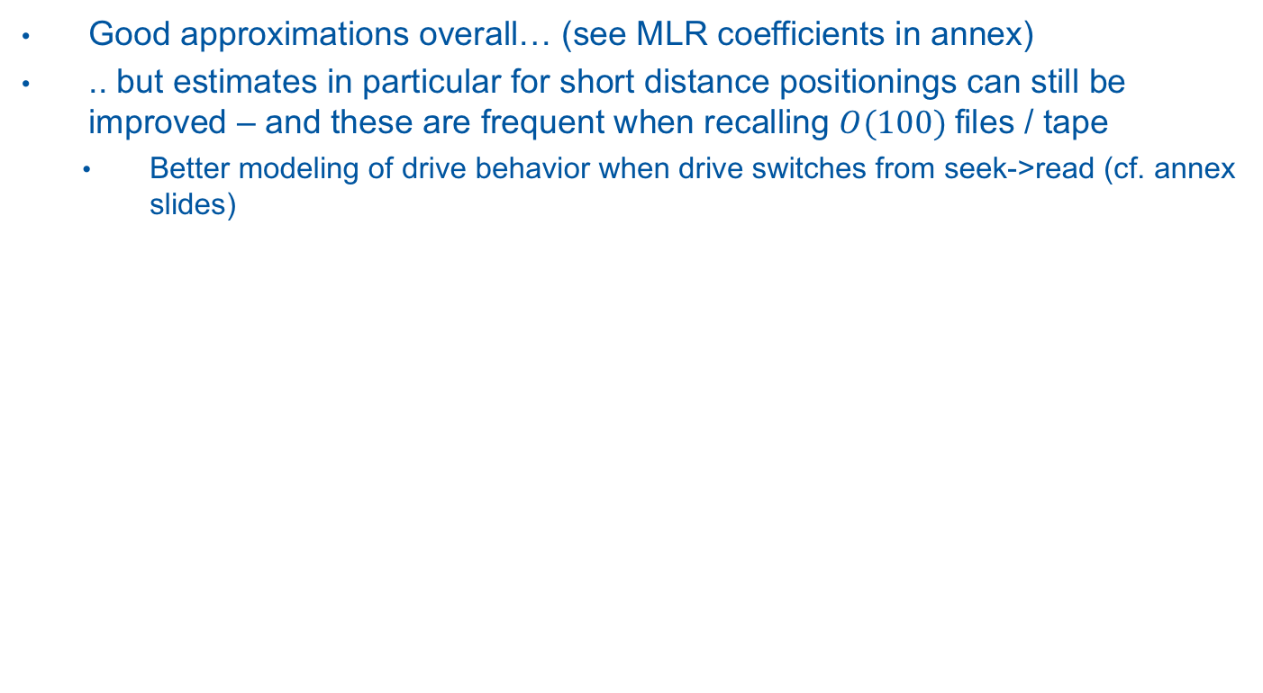
2. Modeling positioning cost (III)
Good approximations overall… (see MLR coefficients in annex)
.. but estimates in particular for short distance positionings can still be improved – and these are frequent when recalling $O(100)$files / tape
Better modeling of drive behavior when drive switches from seek->read (cf. annex slides)
LTO performance – HEPiX Fall 2018 – German.Cancio@cern.ch

Slide 17
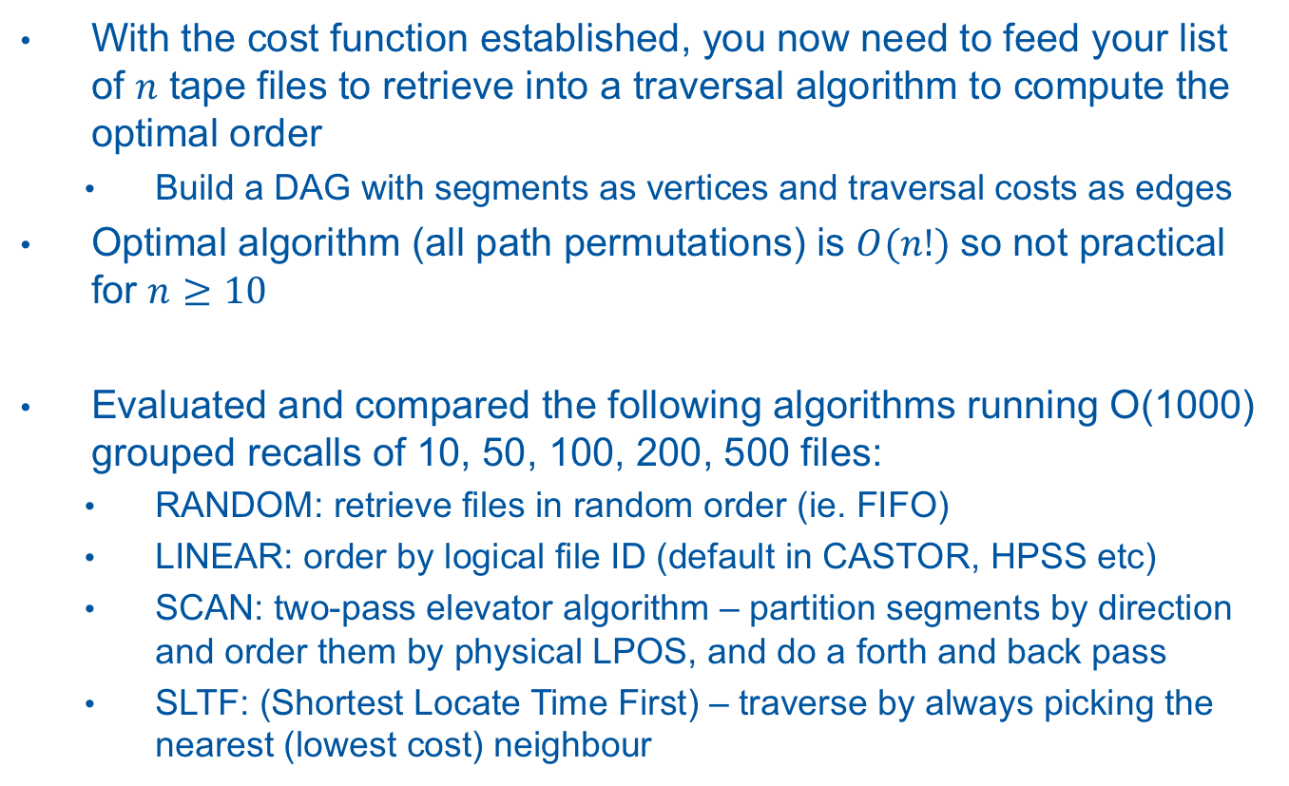
3. Traversal algorithm (I)
With the cost function established, you now need to feed your list of $n$ tape files to retrieve into a traversal algorithm to compute the optimal order
Build a DAG with segments as vertices and traversal costs as edges
Optimal algorithm (all path permutations) is $O(n!)$so not practical for $n≥10$
Evaluated and compared the following algorithms running O(1000) grouped recalls of 10, 50, 100, 200, 500 files:
RANDOM: retrieve files in random order (ie. FIFO)
LINEAR: order by logical file ID (default in CASTOR, HPSS etc)
SCAN: two-pass elevator algorithm – partition segments by direction and order them by physical LPOS, and do a forth and back pass
SLTF: (Shortest Locate Time First) – traverse by always picking the nearest (lowest cost) neighbour
LTO performance – HEPiX Fall 2018 – German.Cancio@cern.ch

Slide 18
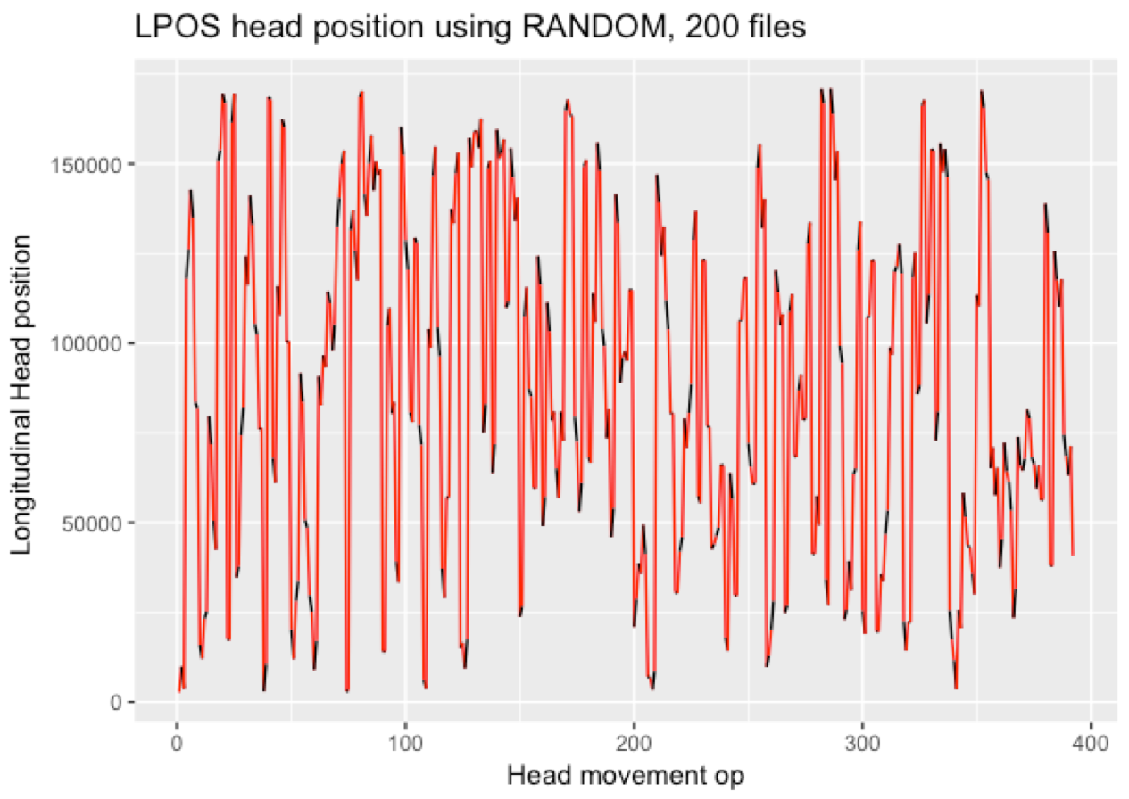
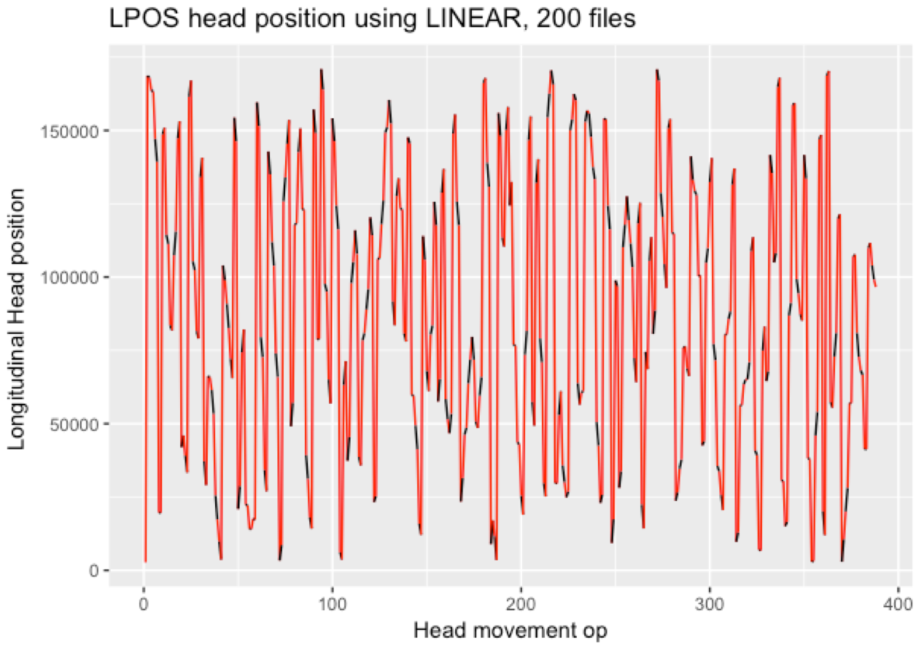
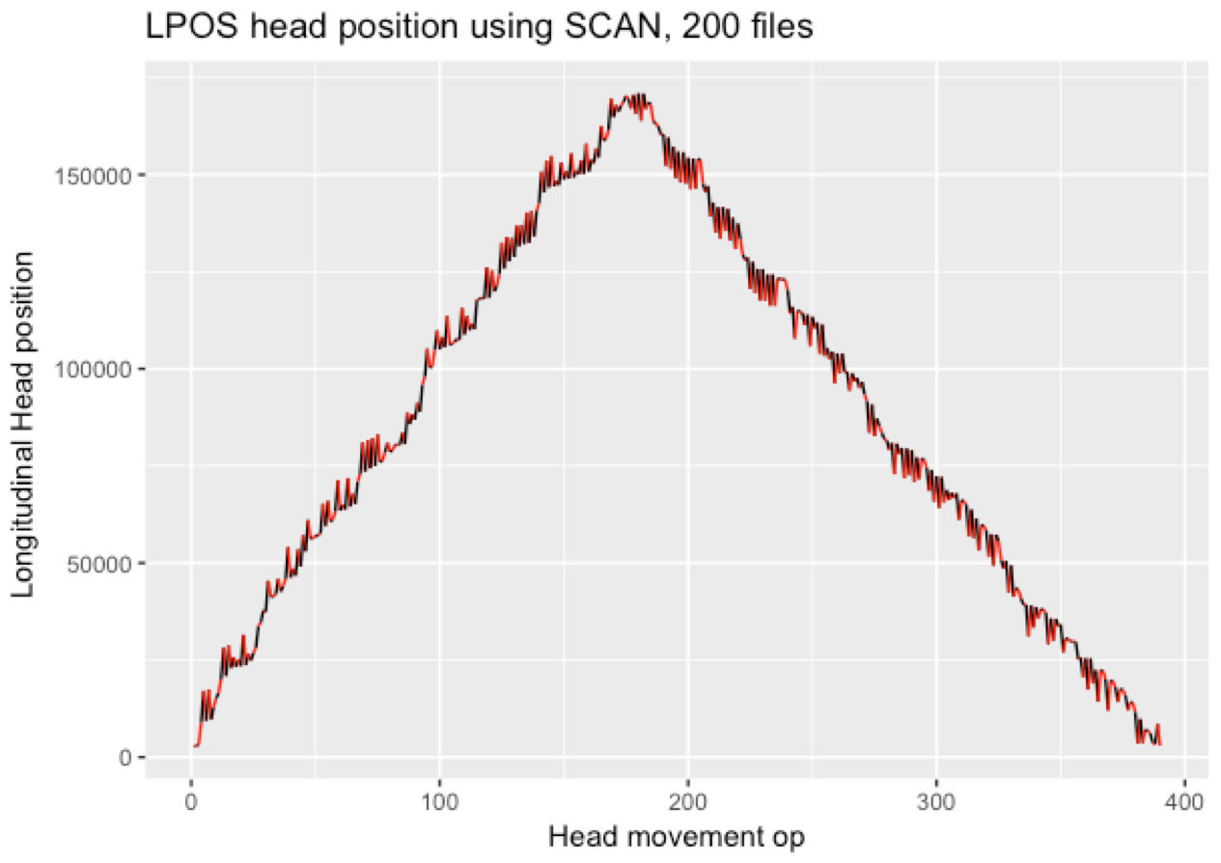
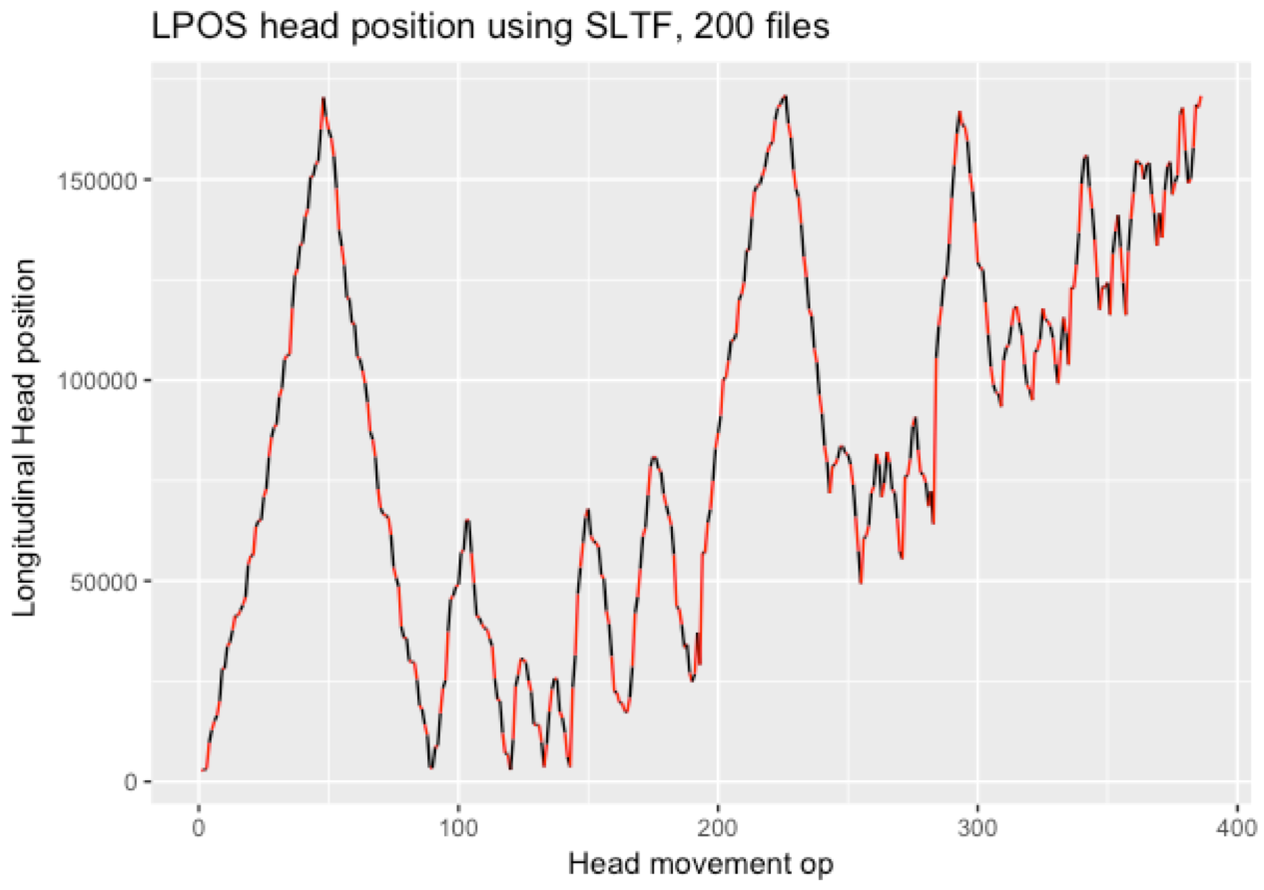
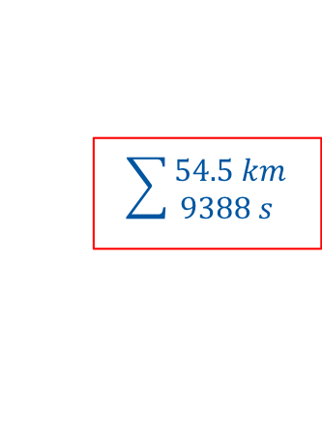
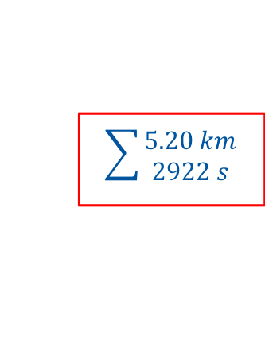


3. Traversal algorithm (II) Example: retrieving same 200 files from same tape
: positioning movement
: reading movement
$$\sum{\begin{aligned}54.5 km \\ 9388 s \end{aligned}}$$
$$\sum{\begin{aligned}57.1 km \\ 8374 s \end{aligned}}$$
Media length (~1km)
$$\sum{\begin{aligned}4.38 km \\ 4858 s\end{aligned}}$$
$$\sum{\begin{aligned}5.20 km \\ 2922 s\end{aligned}}$$
LTO performance – HEPiX Fall 2018 – German.Cancio@cern.ch

Slide 19
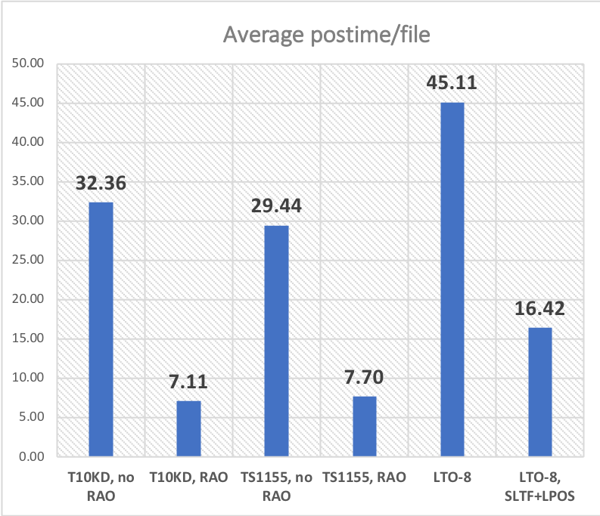
Results so far
Compared to LINEAR and RANDOM, SLTF and SCAN reduce media traversal distance (thus wear) by over 11x
SLTF is the fastest positioning algorithm (~2.5x-3x faster than LINEAR)
Further gains in reach:
Improved local movement modeling
More performant algorithms using heuristics and approximations
A research area for our PhD student starting this month
Support for optimised LTO access will be implemented in the upcoming CERN Tape Archive (CTA) SW during 2019
LTO performance – HEPiX Fall 2018 – German.Cancio@cern.ch

Slide 20
Summary
LTO-8 is an interesting alternative/complement to IBM enterprise offering a very attractive price/TB
LTO lacks drive-assisted reordering of file requests, making reading much slower -> significant impact for “tape carousel” activities…
… but this reordering can be implemented outside the drive!
Internal (undocumented) drive parameters can be inferred via linear regression techniques
Positioning times can be improved by an average factor of 2.5x-3x, and media traversal (thus wear) reduced by over an order of magnitude… and there is still room to improve further…
… making LTO Tape Reading Great (…or better) again
LTO performance – HEPiX Fall 2018 – German.Cancio@cern.ch

Slide 21
Annex and References
LTO performance – HEPiX Fall 2018 – German.Cancio@cern.ch

Slide 22
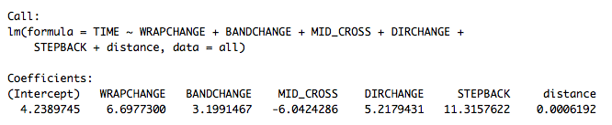
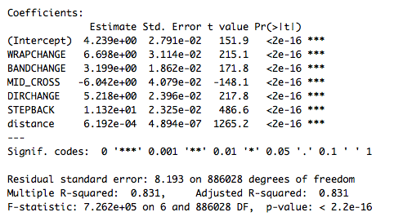
Linear Regression coefficients
base repositioning overhead (in s)
wrap change (in s)
band change (in s) [on top of wrap change]
Crossing mid-tape (in s) [negative: faster]
direction change (in s)
stepback (in s)
distance factor (seconds/LPOS unit)
LTO performance – HEPiX Fall 2018 – German.Cancio@cern.ch

Slide 23
Positioning speed and crossing mid-tape (change of positioning area)
drive positioning at seek speed (8.5-9m/s)
drive positioning at read speed (~5.25m/s)
LTO performance – HEPiX Fall 2018 – German.Cancio@cern.ch

Slide 24
Positioning speed within same wrap
LTO performance – HEPiX Fall 2018 – German.Cancio@cern.ch

Slide 25
Expected vs observed positioning times
LTO performance – HEPiX Fall 2018 – German.Cancio@cern.ch

Slide 26
Expected vs observed positioning times
most positioning operations are within short distances when exercising “Data Carousel” type recalls (~50-500 files / mount)
LTO performance – HEPiX Fall 2018 – German.Cancio@cern.ch

Slide 27
Impact of “landing” behavior on performance
To be investigated: landing behavior
local “key points” or “landing points”: index areas
on media where drive can switch from seek->read
cf. papers by Hillyer+Sandsta
wraps
0
1
2
3
: tape head local landing points (from seek to read)
: distance to beginning of file to be traversed at reading speed
LTO performance – HEPiX Fall 2018 – German.Cancio@cern.ch

Slide 28
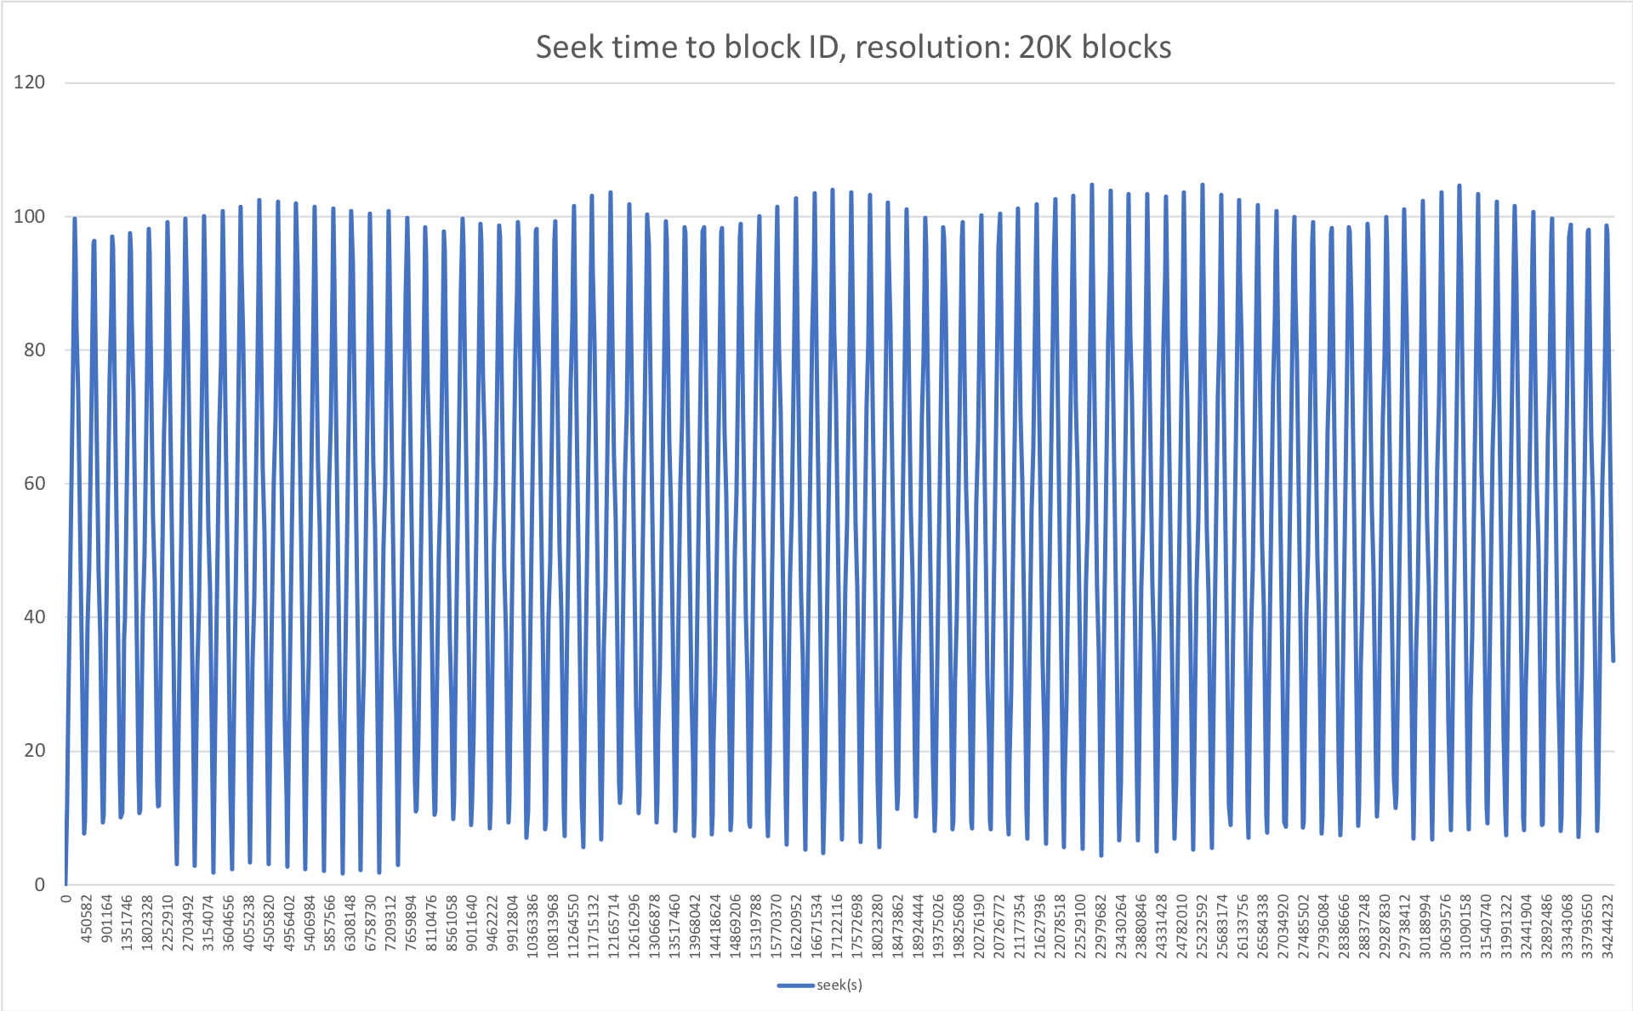
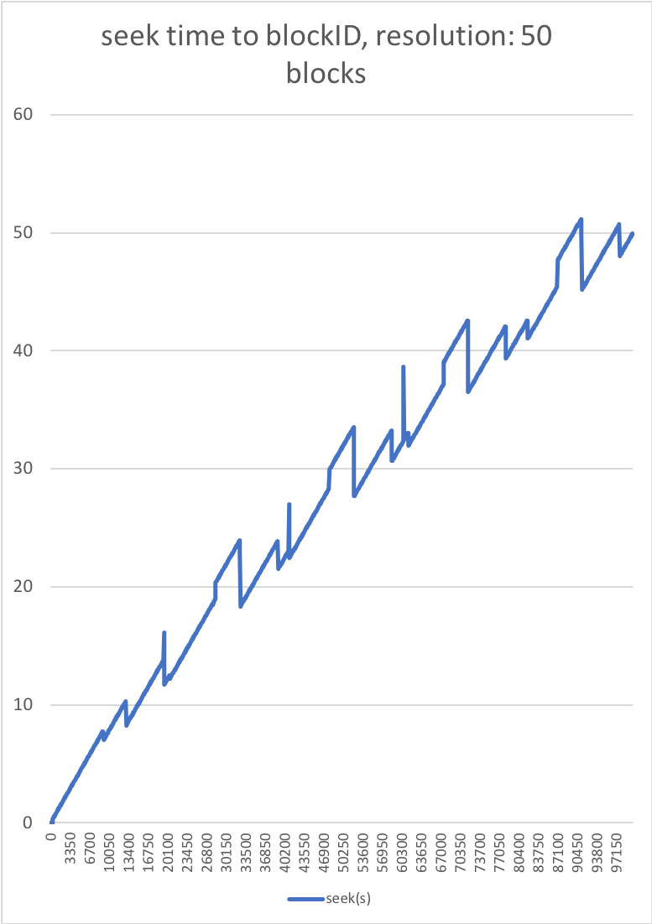
Local landing points and positioning times
LTO performance – HEPiX Fall 2018 – German.Cancio@cern.ch

Slide 29
References
IBM TotalStorage LTO Ultrium Tape Drive SCSI reference
B. K. Hillyer and A. Silberschatz. On the modeling and performance characteristics of a serpentine tape drive. Proceedings of the 1996 ACM Sigmetrics Conference on Measurement and Modeling of Computer Systems, pages 170- 179, Philadelphia, Pennsylvania, May 1996.
B. K. Hillyer and A. Silberschatz. Random scheduling in online tertiary storage. In Proceedings of the 1996 ACM SIGMOD International Conference on Management of Data, pages 195-204, Montreal, Canada, June 1996.
O. Sandsta and R. Midstraum. Low-Cost Access Time Model for Serpentine Tape Drives. 16th IEEE Symposium on Mass Storage Systems and the 7th NASA Goddard Conference on Mass Storage Systems and Technologies, pages 116–127, San Diego, California, USA, March 1999.
O. Sandsta and R. Midtstraum. Improving the access time performance of serpentine tape drives. 15th International Conference on Data Engineering, Sydney, Australia, March 1999.
LTO performance – HEPiX Fall 2018 – German.Cancio@cern.ch

